Slide 1

Rockbuster Stealth
2020 Marketing Strategy by Stefan Hulaj
Notes:
To change the image on this slide, select the picture and delete it. Then click the Pictures icon in the placeholder to insert your own image.

Slide 2
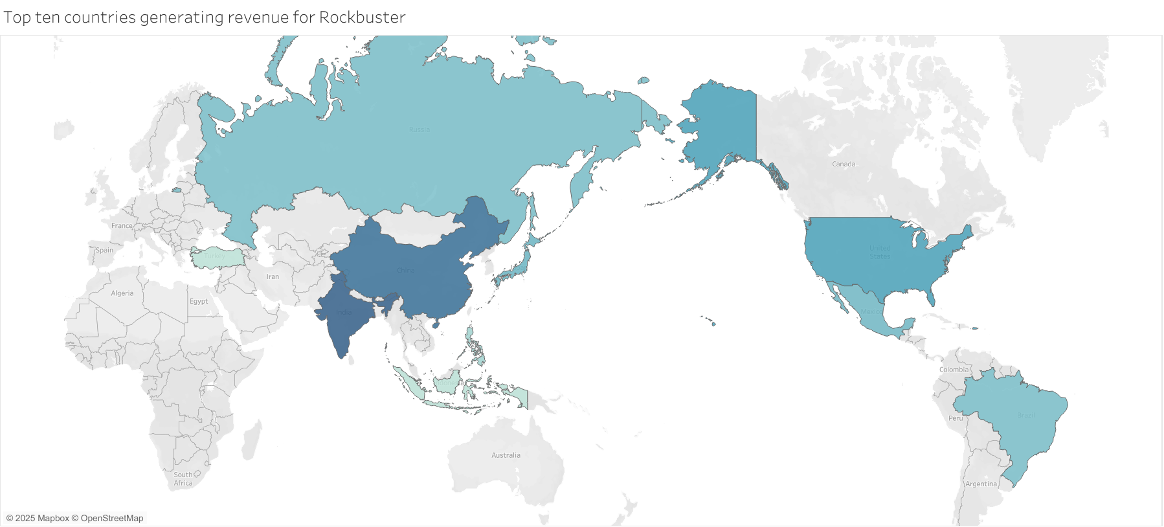
Top ten countries generating revenue for Rockbuster Stealth
This is a map of the top countries generating revenue for Rockbuster Stealth.

Slide 3
Rockbuster Stealth Statistics
Average movie rental duration: 5 days
Average movie rental rate: 3 Dollars
Average film length: 115 minutes

Slide 4
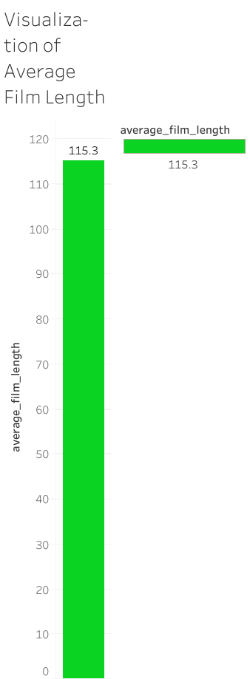
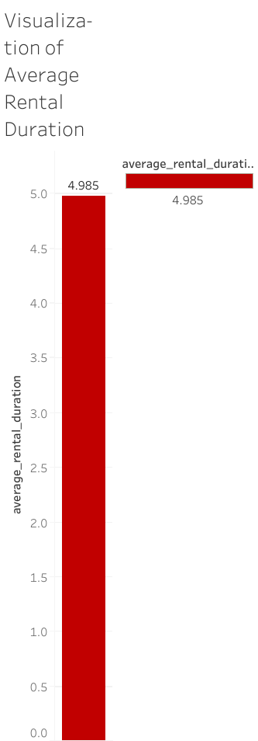
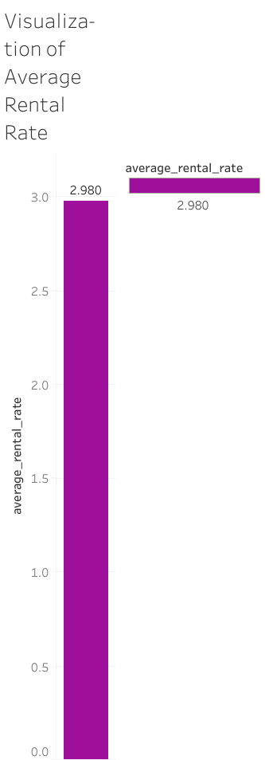
Visualizations of Averages

Slide 5
Recommendations
Focus on markets in China and India. Most of our sales are in those countries.
Incentivize customers to rent more movies through promotions.
Prioritize acquiring longer movies to ensure customers rent them longer.

Slide 6
Tableau Link
https://public.tableau.com/app/profile/stefan.hulaj/viz/Exercise3_10Averages/Sheet1?publish=yes&showOnboarding=true

